Slide 1

Sentiment Analysis By Using TripAdvisor Dataset of US Hotel Review
Suraj Meshram

Slide 2
Agenda
Data Overview
Goal Of Analysis
Stages for Data Analysis
Perform Sentiment Analysis
Results
Future Scope

Slide 3
Data Overview
Data Source: TripAdvisor.com
Basic Statistics of Dataset:
Dataset Contain Four columns: Reviews, Date, Location, Review Website
Number Of Reviews: 6448
Number Of Location: 1711
Review Website:1

Slide 4
Goal Of Analysis
To perform analysis on raw data and apply statistical analysis and various technologies on data to find trends and get insights.
For sentiment analysis , Text Data Pre-Processing and to understand the feeling expressed and categorize English text review into positive, negative and neutral.
​

Slide 5
Goal Of Analysis
To perform analysis on raw data and apply statistical analysis and various technologies on data to find trends and get insights.
Data Preparation : Used for data is scanned to get familiar with data identify quality of problem and discover first insights into it like checking number and types of features, descriptive statistics, visualisation, missing values, inconsistence data record etc.
Preforming EDA : get insights and find meaningful patterns in data, detect seasonality, and trend, and establish cause and effect relationships in data.
​
Shape Of Data
to check total No of row and columns
Data Types
to check columns and Count of Categorical and numerical
% OF Missing Values
To calculate % Of miss value and visualize them
Visualize Outliers
Performing Uni & Bivariate Analysis
To detect outlier using Box Plot
To check relationship variable level

Slide 6
2.For sentiment analysis , Text Data Prep-Processing and to understand the feeling expressed and categorize English text review into positive, negative and neutral.
Raw text data might contain unwanted or unimportant text due to which our results might not give efficient accuracy, and might make it hard to understand and analyze. So, proper pre-processing must be done on raw data.
list of preprocessing process that can perform on text data such as:
Handling Missing values and Duplicates values
Handling Outlier
Text Lowercasing
Removing Non-Alphabet words(Special Character)
Stopword
Stemming
Calculate Sentiment score for each review and Classify sentiment
​

Slide 7
Final Analysis
Review In Month
Sentimental change over month
​
Above plot say that ,Out of a total of 6,448 reviews, 40% (2,592) were in 2018 and 60% (3,856) were in 2019. This means that in 2019, 20% more reviews were received compared to 2018.
Above plot trend line say that , In year 2018 it is observed that no reviews are reported first two quarters but after August the count of reviews has increased. Whereas in year 2019 reverse trend is observed, All the reviews are reported in first 3 quarters and no reviews are recorded in last quarter.

Slide 8
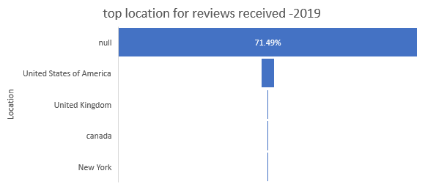
Top Month for Received Reviews
Top location For Review For 2019
​
In year 2019 Location for 71.49% reviews is missing, about 3.01% reviews are reported in USA whereas 0.96% reviews are reported in UK, Canada and New York.
In year 2019 highest number of reviews are reported in months of March, April and July. Similarly highest number of reviews for year 2018 are reported in months of October, Nov, Dec.
Location | % of Review | Count of Review
null | 71.49% | 1049
United States of America | 3.15% | 55
United Kingdom | 0.36% | 14
canada | 0.31% | 12
New York | 0.29% | 11

Slide 9
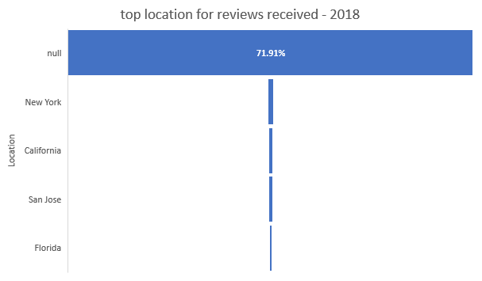
Top location For Review For 2018
​
Location | % of Review | Count of Review
null | 71.91% | 1543
New York | 1.08% | 28
California | 0.62% | 16
San Jose | 0.62% | 16
Florida | 0.50% | 13
In year 2018 Location for 71.91% reviews is missing, about 1.08% reviews are reported in New York whereas 1.74% reviews are reported in California ,San Jose & Florida .

Slide 10
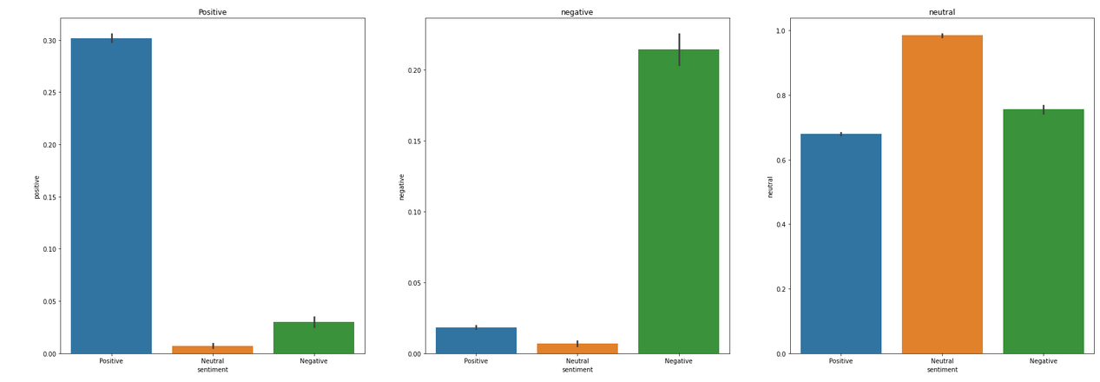
Result and Conclusion:
In this Analysis, I am successfully classified sentiment that there is 72.41% is classify as Positive sentiment, 15.21% is classify as Neutral sentiment and approximate 5% are classify as Negative sentiment.
Number of Positive Sentiment: 4669
Neutral Sentiment: 981
Negative Sentiment: 269
Following image gives a better overview of the classification of the reviews into correct sentiments:
​

Slide 11
Result and Conclusion:
The insights gained from this project can help hotel managers improve their service and offerings, ultimately leading to increased customer satisfaction and loyalty. As users, the best way to know if a hotel is right for you or not is to find out what other people are saying about the hotel on various social media sites or news outlets.
​

Slide 12
Future Scope
The insights gained from this project can help hotel managers improve their service and offerings, ultimately leading to increased customer satisfaction and loyalty. As users, the best way to know if a hotel is right for you or not is to find out what other people are saying about the hotel on various social media sites or news outlets.
Next Steps :
Feature Selection
Model Building
​

Slide 13
Thank you
Suraj Meshram
surajmeshram994@gmail.com​​

